Slide 1
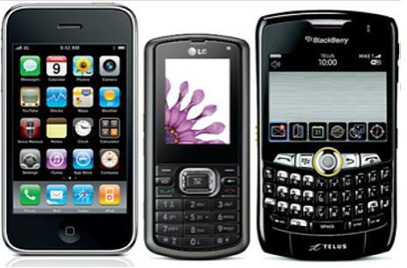
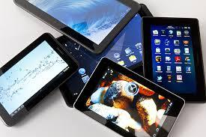
Welcome to the LME
Media Center

Slide 2
Media Center Orientation
General Information
Rituals and Routines
Borrowing Library Books
Lexile Measure
eBook Collection
eBook Recommendations
Questions and Concerns

Slide 3
General Information
Media Specialist (Librarian)
Ms. Daniels
Hours of Operation (Students)
7:30 AM – 3:00 PM daily
Checkout Ends at 2:00 PM

Slide 4
General Information (Conti.)
No food or drinks are allowed in the media center.
Keep the media center clean and neat.
Students are to push their chair under the table or computer workstation when they get up.

Slide 5
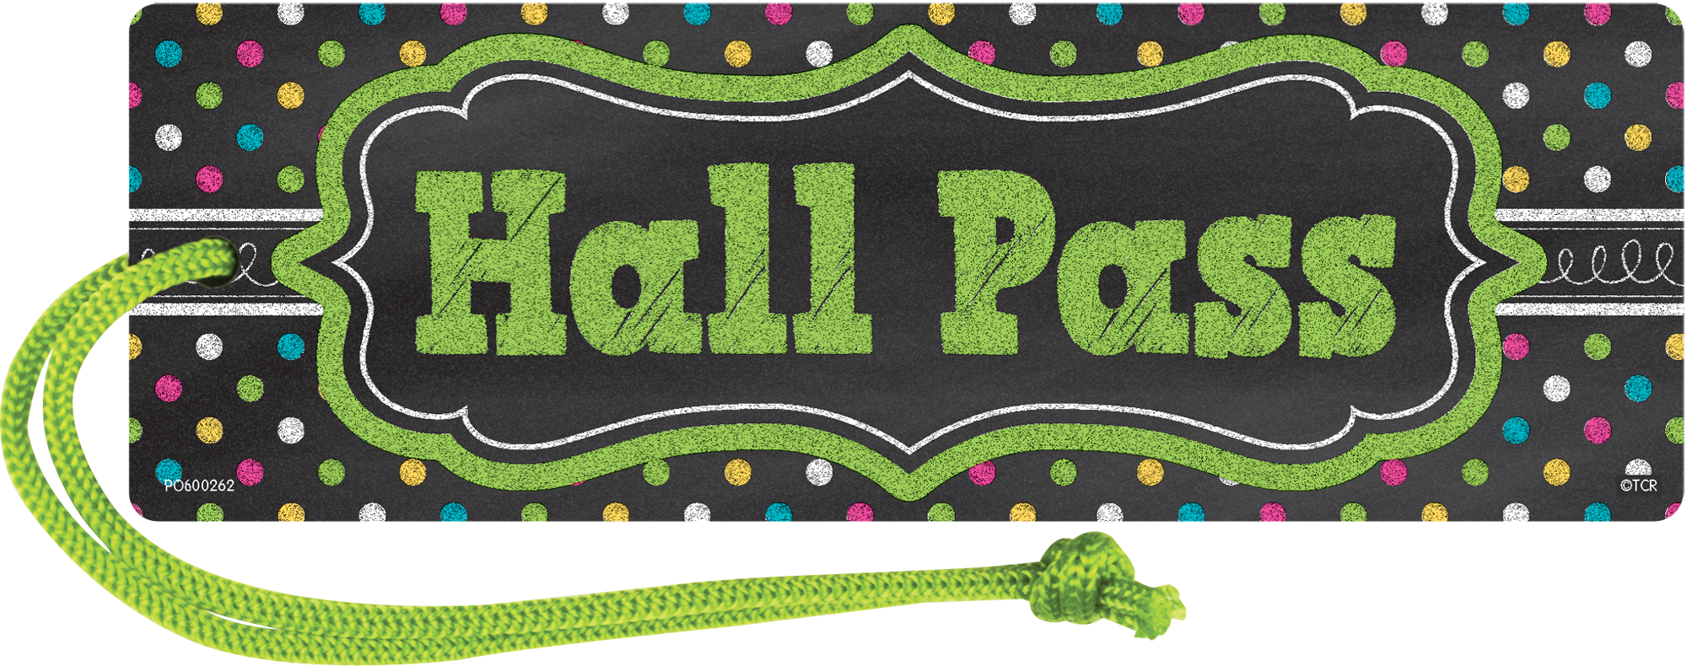
General Information (Conti.)
Students are allowed to visit the media center individually or in small groups (no more than 3) to checkout library books.
If students visit the media center individually or in a small group, they must have a pass from their teacher.

Slide 6
General Information (Conti.)
Students are also allowed to visit the media center with their class for lessons (Information Literacy, Makerspace, and Coding).
Story time will be via Zoom or Teams and is for Pre-K and Kindergarten classes only.

Slide 7
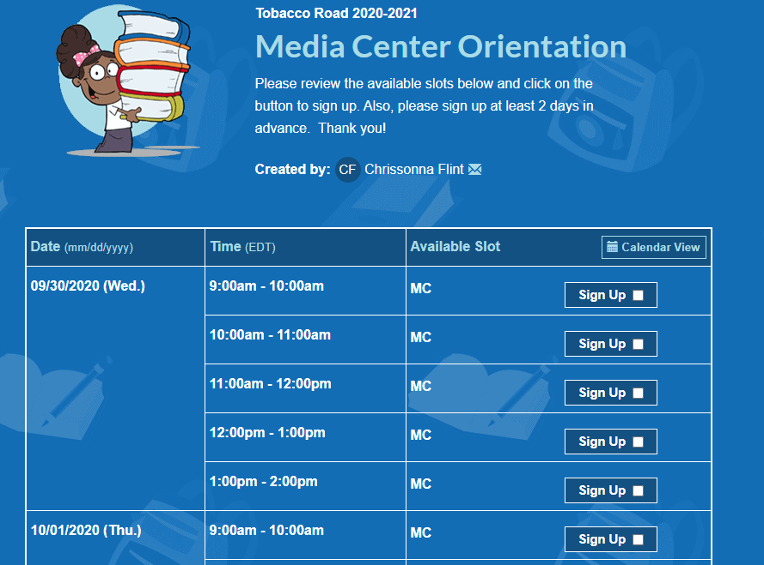
General Information (Conti.)
Teachers will use the sign-up sheets on the school’s website to schedule lessons and story time.

Slide 8
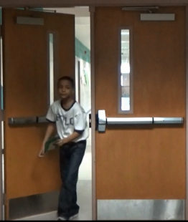
Rituals and Routines
Students are to enter the media center quietly and use their indoor voice during their entire visit.

Slide 9
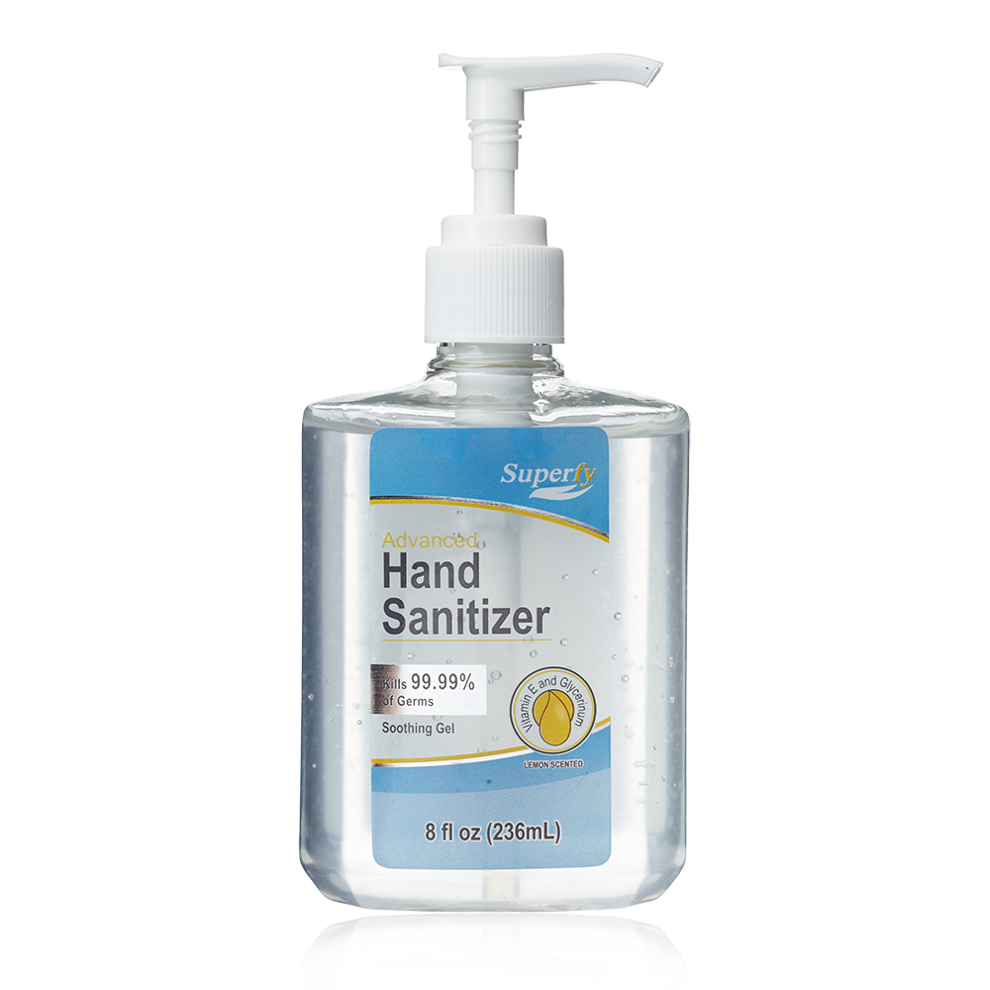
Rituals and Routines (Conti.)
After entering the media center, all students must sanitize their hands with hand sanitizer.

Slide 10
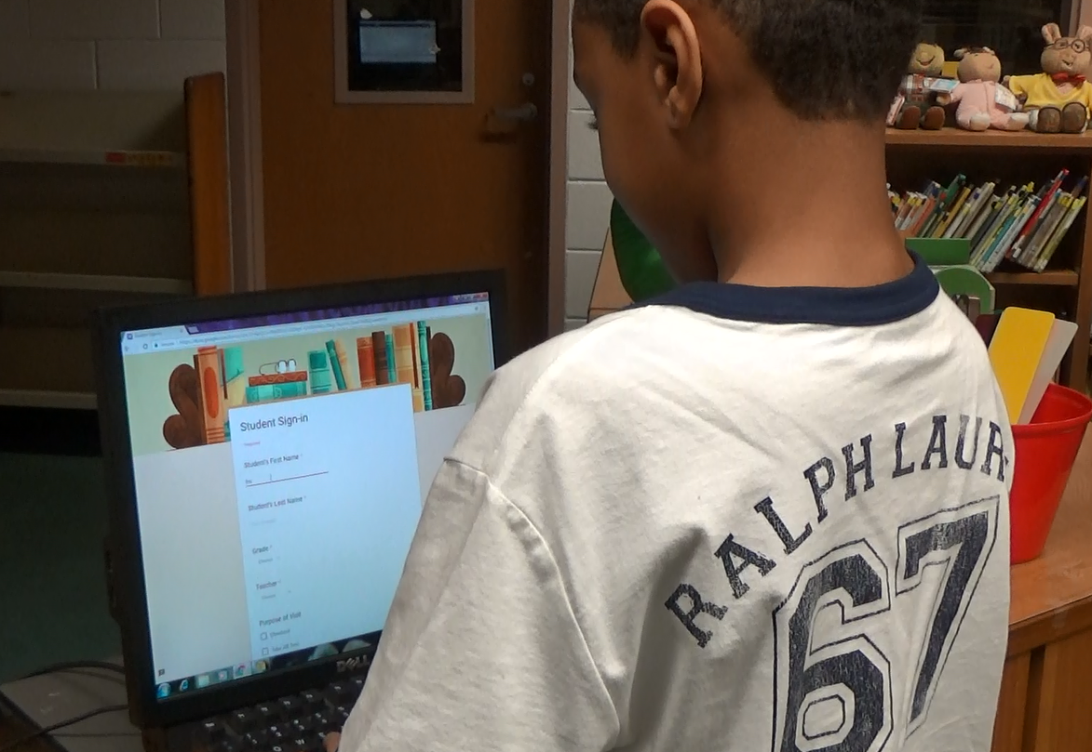
Rituals and Routines (Conti.)
If students visit the media center individually or in small groups, they are no longer required to use the computer at the circulation desk to sign-in.
The media specialist will perform this task for each student.

Slide 11
Rituals and Routines (Conti.)
In order for the media specialist to sign-in students, each student must provide her with the following:
Grade
Homeroom Teacher’s Name
First and Last Name
Purpose of their Visit

Slide 12
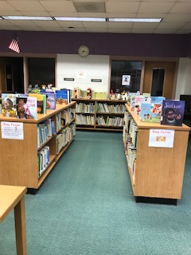
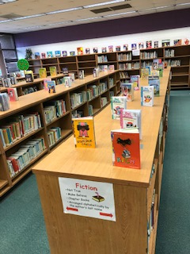
Rituals and Routines (Conti.)
After the media specialist has signed in the student, he/she can proceed to the shelves to search for a library book.
As a precaution, students:
will no longer use shelf
markers.
must select books from the
top of the shelves ONLY!!!

Slide 13
Rituals and Routines (Conti.)
Once the student has retrieved a book from the top of a shelf, he/she can take it to the circulation desk so that it can be checked out in his/her name.

Slide 14
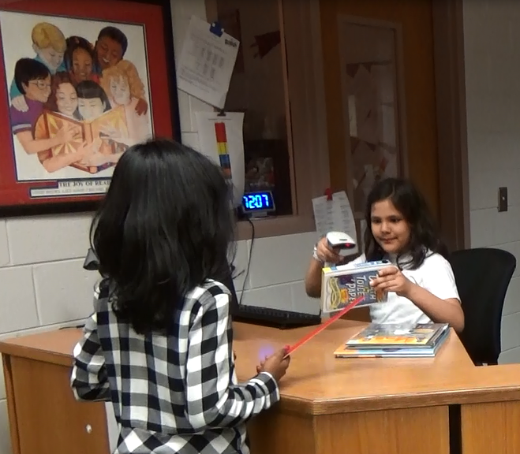
Rituals and Routines (Conti.)
At the circulation desk, students must state their grade, homeroom teacher’s name as well as their first and last name.

Slide 15
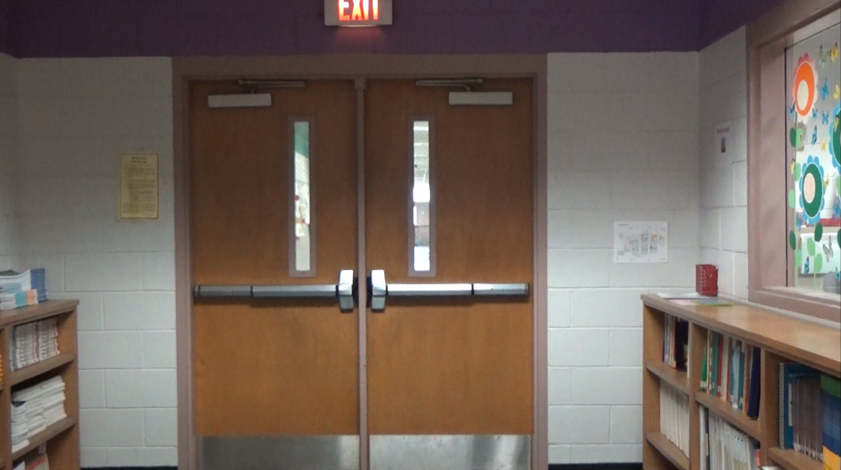
Rituals and Routines (Conti.)
After the book has been checked out in the student’s name, the student will exit the media center.

Slide 16
Borrowing Library Books from the Media Center
Kindergarten students may checkout one library book at a time.
First through Fifth grade students may checkout two library books at a time.
All students may checkout library books for two weeks.
All students are responsible for the library books that they checkout.

Slide 17
Borrowing Library Books from the Media Center (Conti.)
When students return their library book to the media center, they are expected to place their library book(s) in the book return slot. These books will have to quarantine for 5 days.

Slide 18
Borrowing Library Books from the Media Center (Conti.)
Checkout/Overdue notices will be sent out at the end of each grading period.
Late fees are not charged.
Students must pay for lost or damaged books.

Slide 19
Lexile Measure
It is imperative that students obtain
their current Lexile Measure (Reading
Level) from their teacher.
Students will use the Accelerated
Reader to Lexile Conversion Chart
to help them locate books within
their Lexile Range (on their reading
level).
There are several charts on the
wall in the media center and one
posted on the school’s website
under media center.

Slide 20
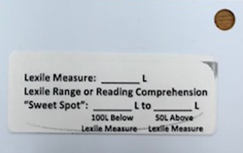
Lexile Measure (Conti.)
Example
If a student’s Lexile Measure is
750L, the student’s Lexile range is
650L to 800L.
Keep in mind that students can
checkout books 100L below their
Lexile Measure and 50L above
their Lexile Measure.
750
650
800

Slide 21
eBook Collection
LME now has a collection of eBooks.
The following slides contain step-by-step instructions for accessing the eBooks.
Instructions can also be found on the school’s website under media center.

Slide 22
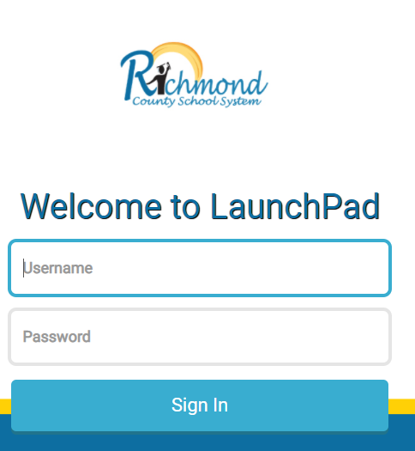
eBook Collection (Conti.)
Step 1: All students will need to log in to LaunchPad.

Slide 23
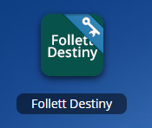
eBook Collection (Conti.)
Step 2: Students are to select Follett Destiny on the Dashboard.

Slide 24
eBook Collection (Conti.)
Step 3: At the top, each student will need to select the Catalog tab.

Slide 25
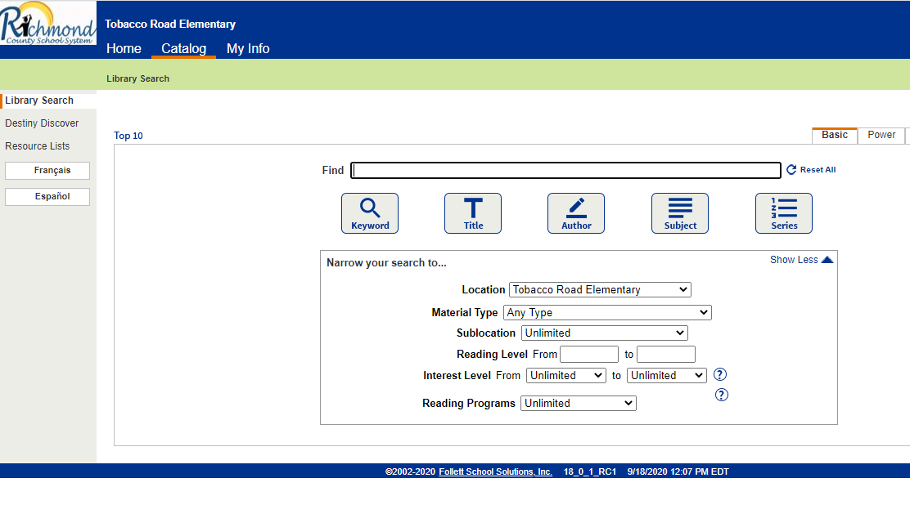
eBook Collection (Conti.)
Step 4: On the left, students are to select Destiny Discover.

Slide 26
eBook Collection (Conti.)
Step 5: Students can search for their eBook.

Slide 27
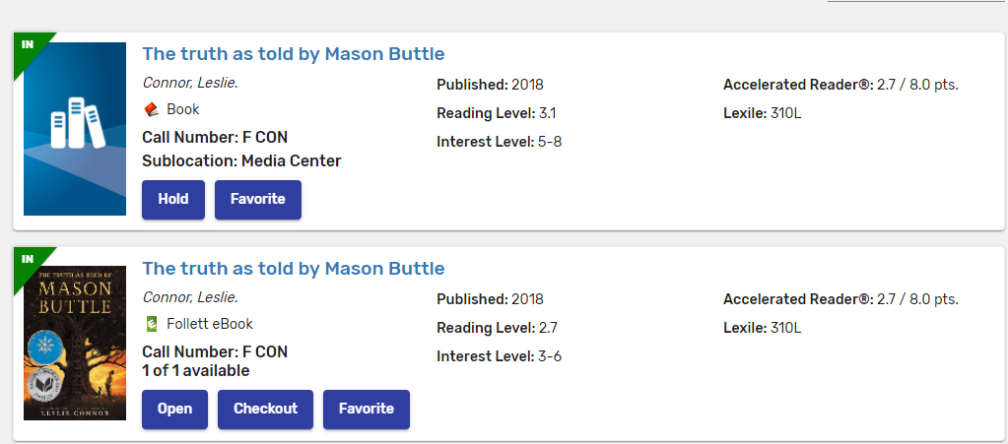
eBook Collection (Conti.)
Step 6: To checkout the eBook, students will need to click Checkout.

Slide 28
eBook Collection (Conti.)
Once an eBook has been checked out, the word Return will appear at the bottom and OUT on the left.

Slide 29
eBook Collection (Conti.)
Students will have two weeks to read and return his/her eBook.
To return the eBook, they will need to click Return.
If a student does not return his/her eBook in two weeks, it will be automatically checked in.

Slide 30
eBook Recommendations
The media specialist’s goal for the 2020-2021 school year is to enhance the number of eBooks in LME’s eBook collection.
What titles would you like to see in LME’s eBook Collection?
Example: Diary of a Wimpy Kid THE MELTDOWN

Slide 31
eBook Recommendations (Conti.)
In order to make your recommendations, click on the picture below or log on to the Internet and go to: https://www.rcboe.org/Page/60696.

Slide 32
Questions/Concerns should be emailed to danieal@boe.Richmond.k12.ga.us

